Slide 1

Prediction of Pedestrian Speed with Artificial Neural Networks
Kejia Gao
Jingyi Zhang
Maximilian Mayr
Yizhi Liu
Felipe Antonio Diaz Laverde
08.07.2024

Slide 2
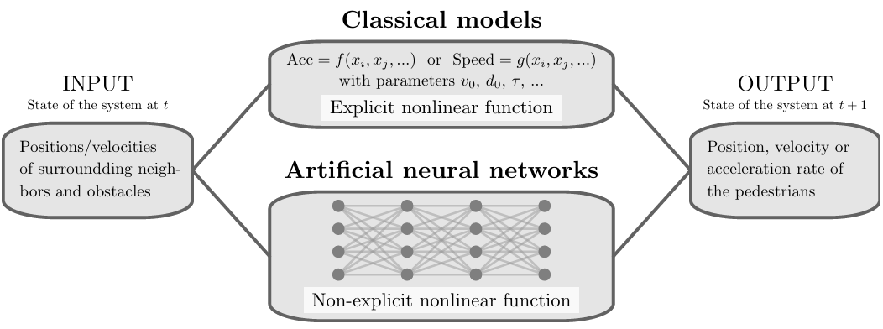
Background of the Research
"Prediction of Pedestrian Speed with Artificial Neural Networks"
by Antoine Tordeux, Mohcine Chraibi, Armin Seyfried, and Andreas Schadschneider
Tordeux A. et al. Prediction of pedestrian speed with artificial neural networks, 2018.

Slide 3
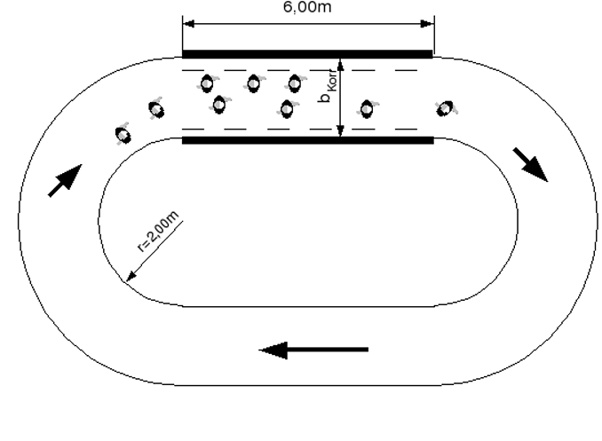
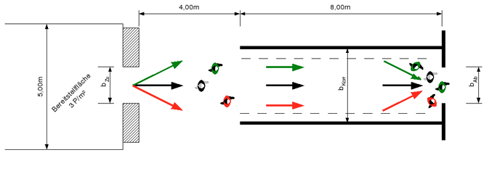
Background of the Research – Data
Project HERMES
Laboratory conditions
Unidirectional
Ring data
Bottleneck data
Sampling frequency 16Hz
50%/50% train-test-split
Keip C, Ries K. Dokumentation von Versuchen zur Personenstromdynamik “[J]. Project Hermes, Bergische Universit ̈at Wuppertal, Tech. Rep, 2009.

Slide 4
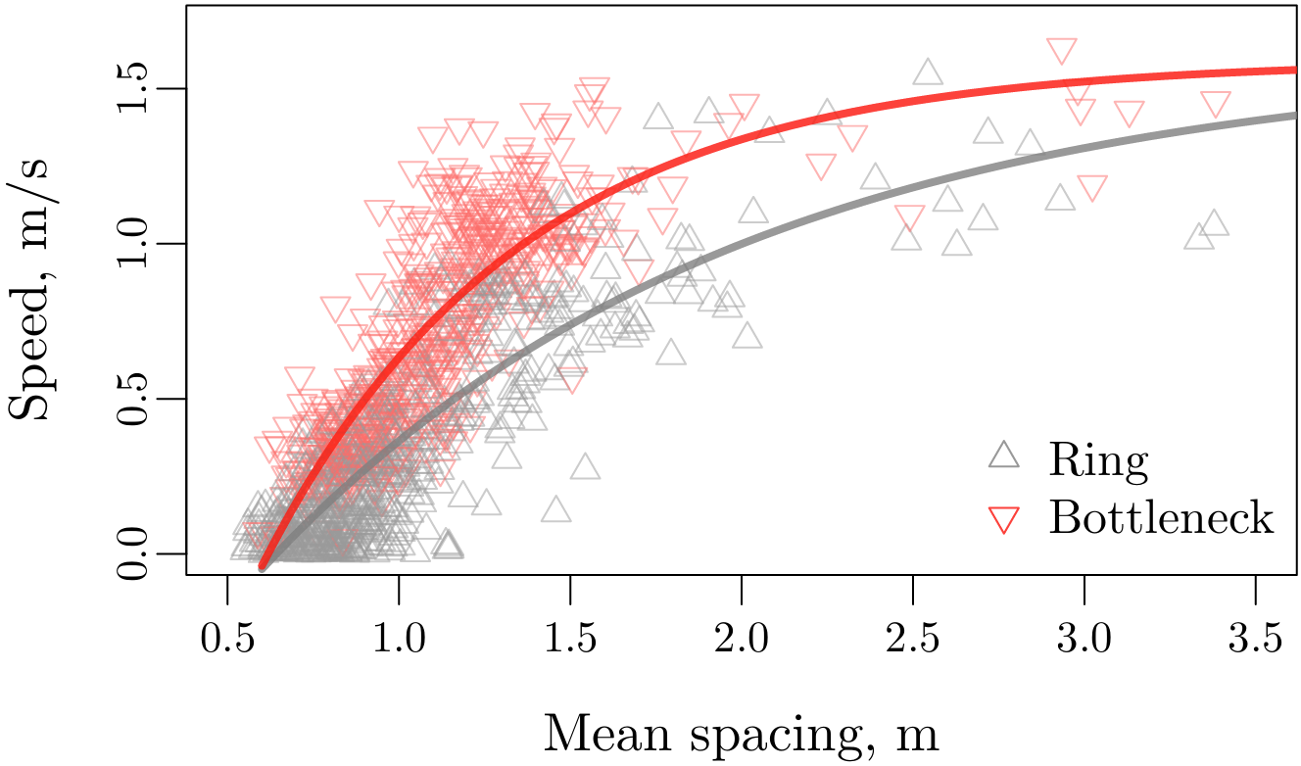
Background of the Research – Data
Tordeux A. et al. Prediction of pedestrian speed with artificial neural networks, 2018.

Slide 5

Background of the Research – Models
Weidmann model
$$v=v_{0}\left(1−\exp\left(\frac{l−{\overline{s}}_{K}}{v_{0}T}\right)\right)$$
Artificial neural network
$$v=NN\left(H, {\overline{s}}_{K},\left(x_{1}−x, y_{1}−y\right), …, \left(x_{K}−x, y_{K}−y\right)\right)$$

Slide 6
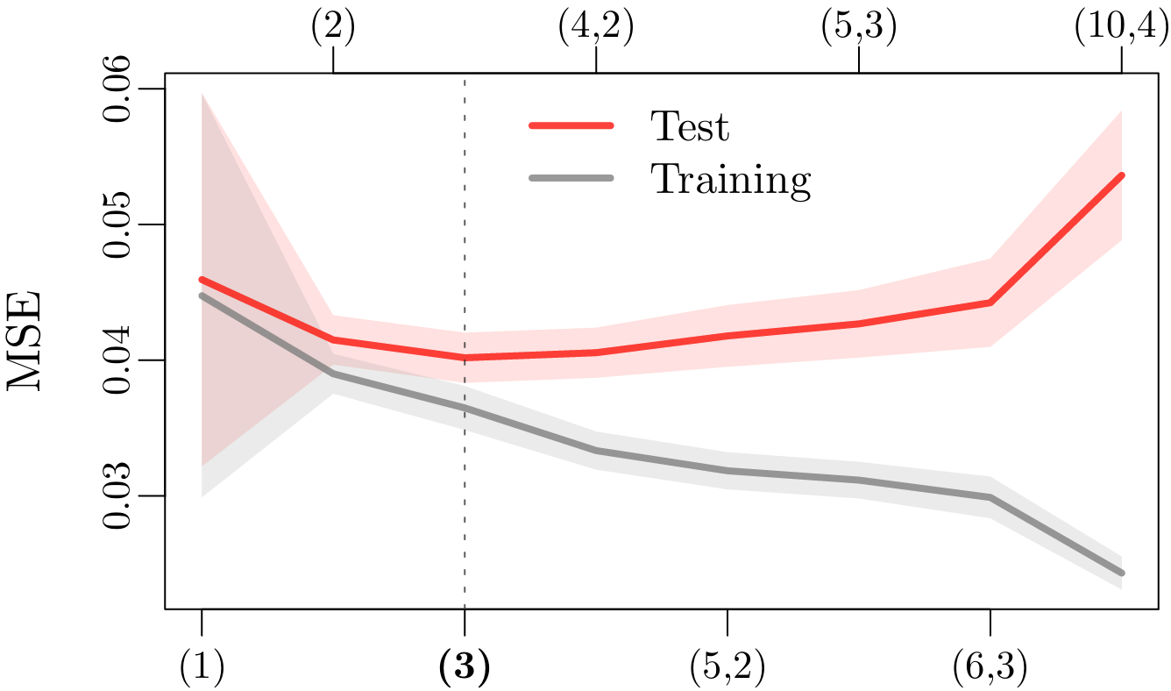
Background of the Research – Results
Tordeux A. et al. Prediction of pedestrian speed with artificial neural networks, 2018.

Slide 7
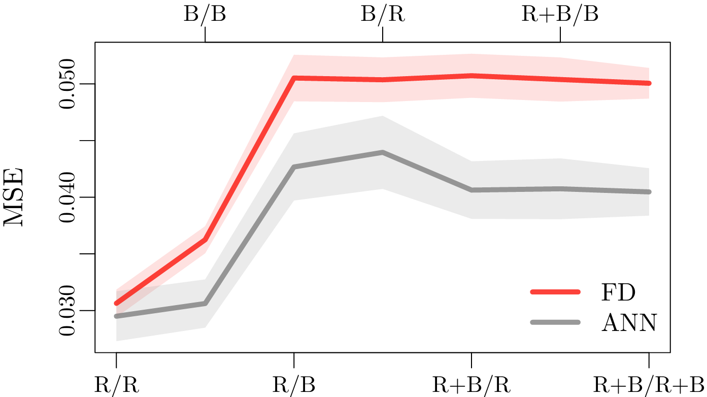
Background of the Research – Results
Tordeux A. et al. Prediction of pedestrian speed with artificial neural networks, 2018.

Slide 8
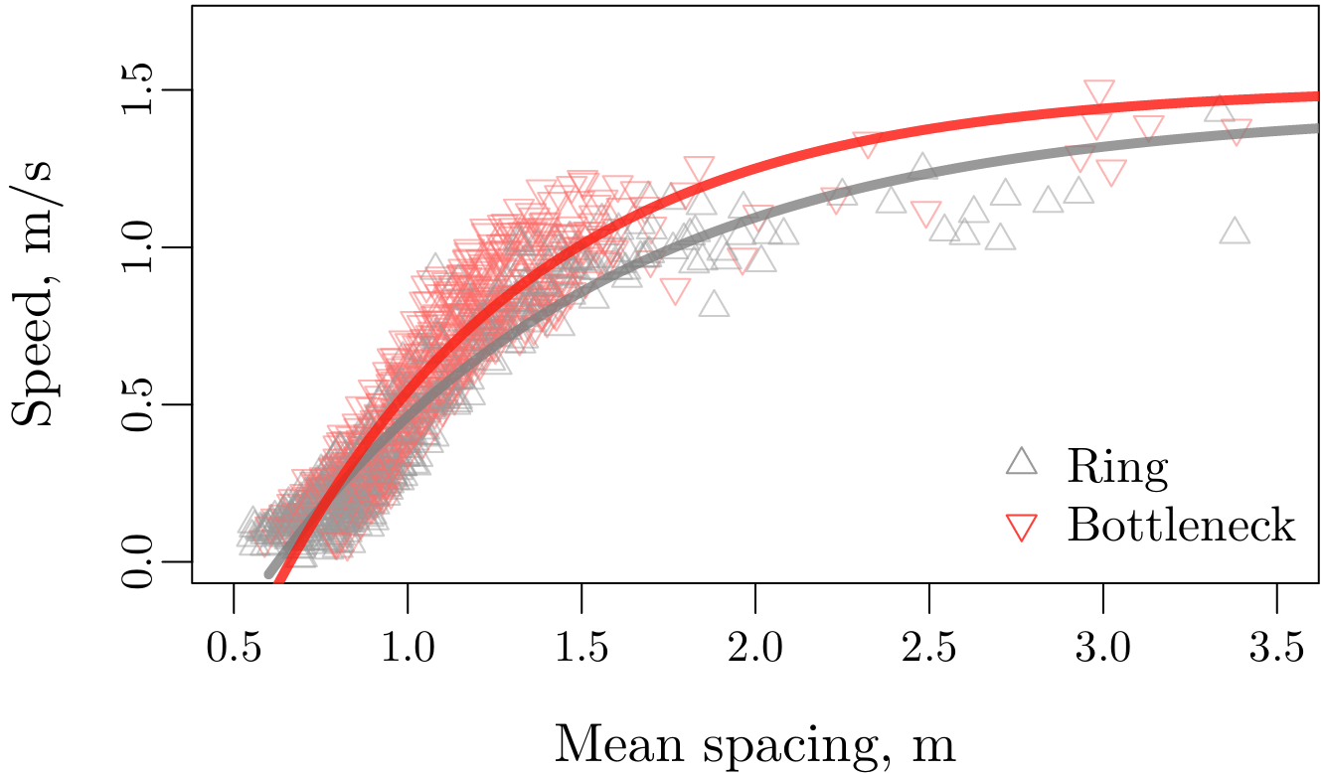
Background of the Research – Results
Tordeux A. et al. Prediction of pedestrian speed with artificial neural networks, 2018.

Slide 9
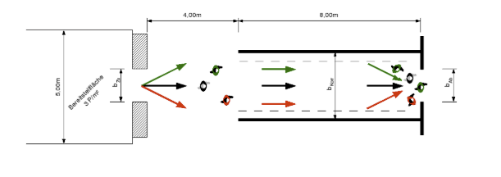
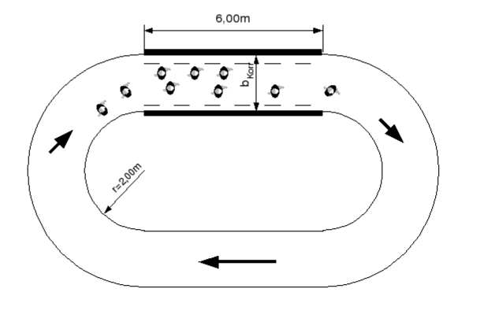
Data preprocessing
Dataset Overview: 2 scenarios
Bottleneck: The width of the system in front of the bottleneck is 1.8 m while the width of the bottleneck varies (from 0.70, 0.95, 1.20 to 1.80 m — 150 participants by experiment)
Corridor: Closed geometry of length 30 m and width 1.8 m for different density levels (the participant number ranges from 15 to 230)
Keip C, Ries K. Dokumentation von Versuchen zur Personenstromdynamik “[J]. Project Hermes, Bergische Universit ̈at Wuppertal, Tech. Rep, 2009.

Slide 10
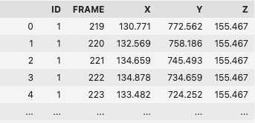
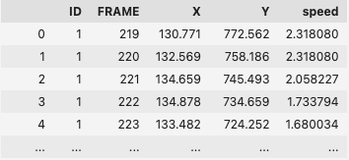
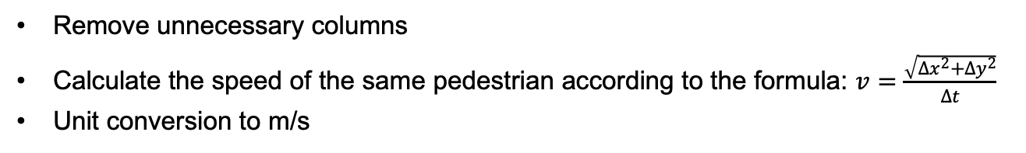
Data preprocessing
Adding speed:
Remove unnecessary columns
Calculate the speed of the same pedestrian according to the formula: $v=\frac{\sqrt{{∆x}^{2}+{∆y}^{2}}}{Δt}$
Unit conversion to m/s

Slide 11
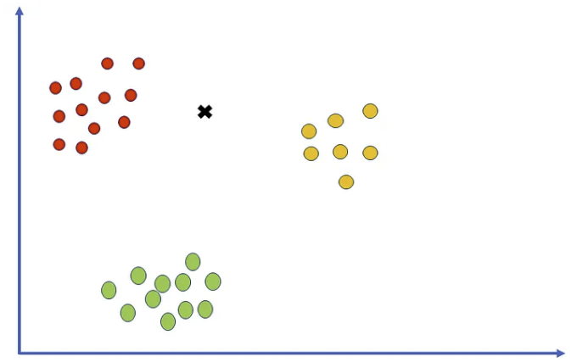

Data preprocessing
Finding nearest neighbors:
Grouping by Frame
Finds the 10 nearest neighbors for each point using Euclidean distance
calculates the mean spacing with the formula:
https://pub.towardsai.net/k-nearest-neighbors-knn-algorithm-tutorial-machine-learning-basics-ml-ec6756d3e0ac
Feature: Distance to neighbors, mean spacing
Target: Speed

